Slide 1

Your Next Job is One Click Away
Ricardo Deodutt
CT101 - MN1

Slide 2
EmployME
EmployME is a brand new phone App that has a sole purpose in helping others. The name of the APP tells the whole story of what this App does. This app helps users find jobs around their area. Users can also find local events to visit. I chose this idea because many students, like myself, are constantly looking for jobs after college.

Slide 3
EmployME
There are many other Apps in the market that have the same idea as EmployME. The two main competitors, Indeed and Linkedin, are apps that I will be using as guidelines. Even though they will be used as guidelines, my app will be different.
Information will be much simpler.
I will go towards a cartoon-y approach instead of a professional approach, in order to cater to a younger generation.

Slide 4


Logo Development
Original
Final
Inspiration

Slide 5
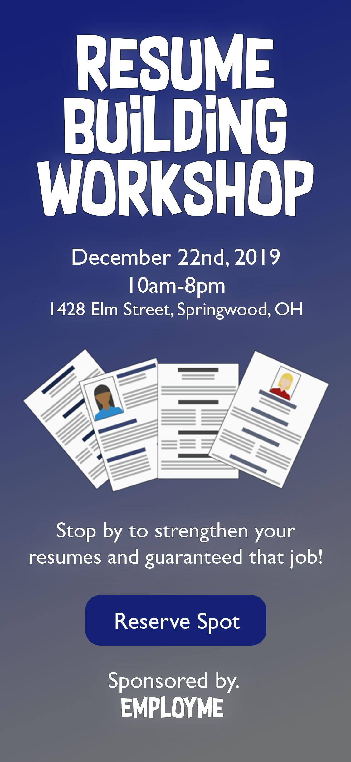
Event Flyer

Slide 6
‹#›
User base
New York
At the launch of this app, only people in New York will be able to use it.

Slide 7
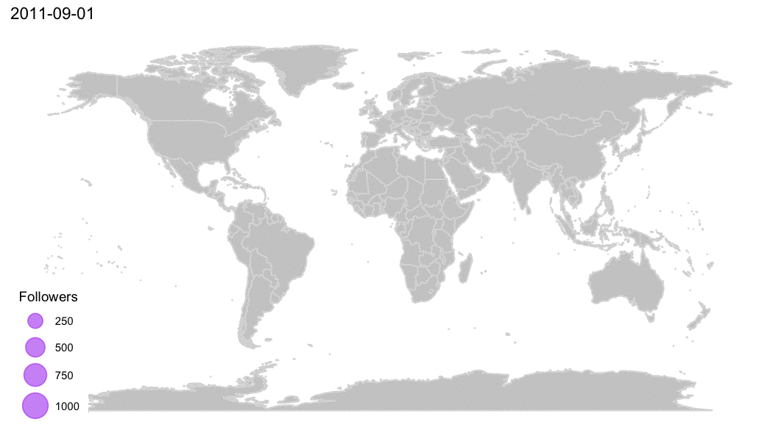
‹#›
User base
As time goes on and more people download the app, the goal is to make this application world wide.

Slide 8
Survey - Data Results

Slide 9
What is the Demography?
This application is targeted mostly towards college students. This survey was sent out to college students around the age of 18-25.
There was 17 users total.
Most users attended Queens College.
Majority of the users are 21 years old.

Slide 10
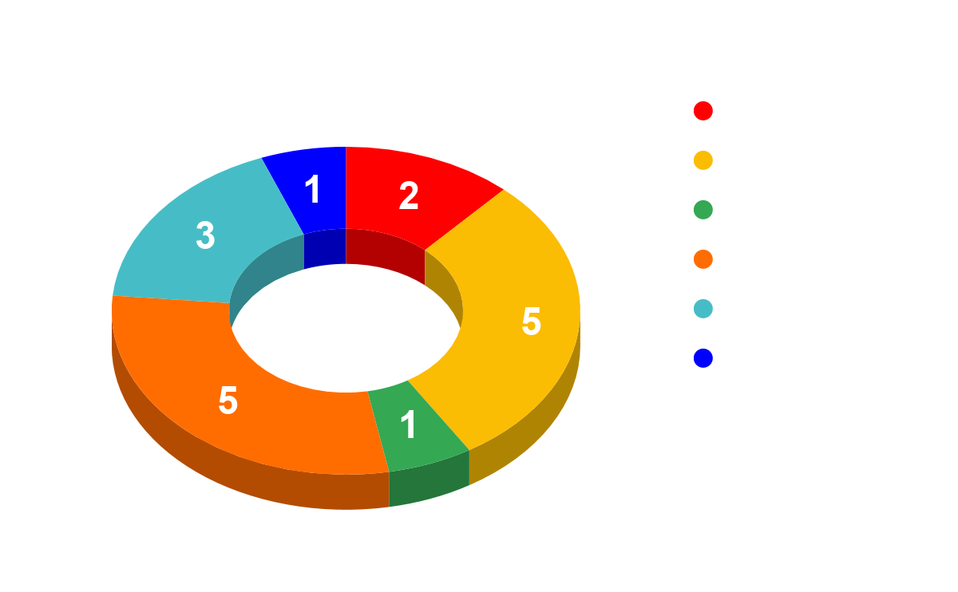
User Research

Slide 11
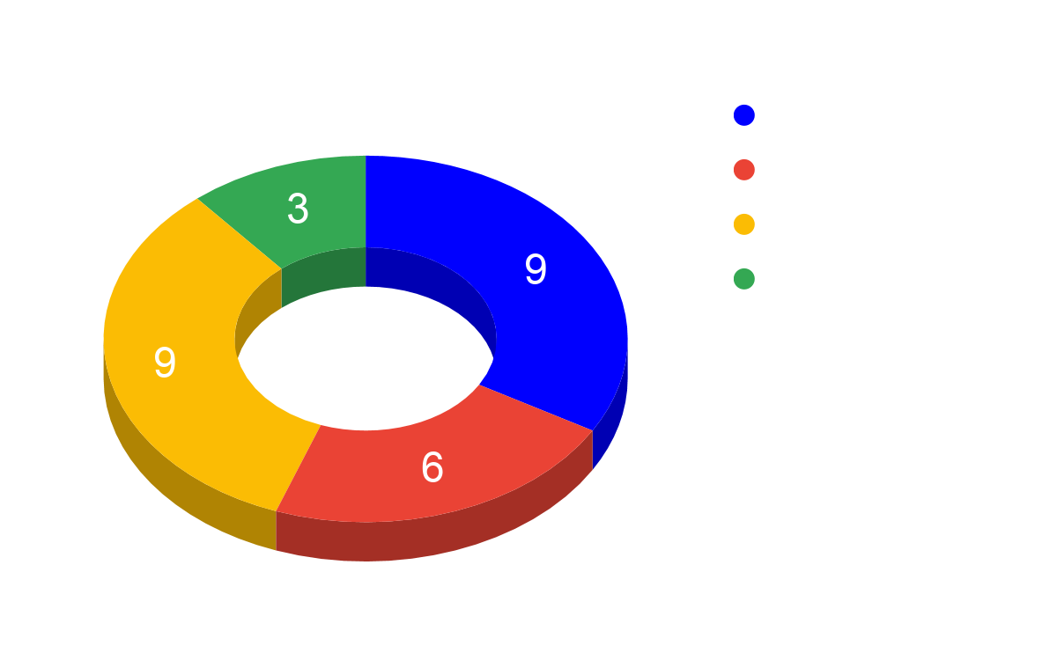
User Research

Slide 12
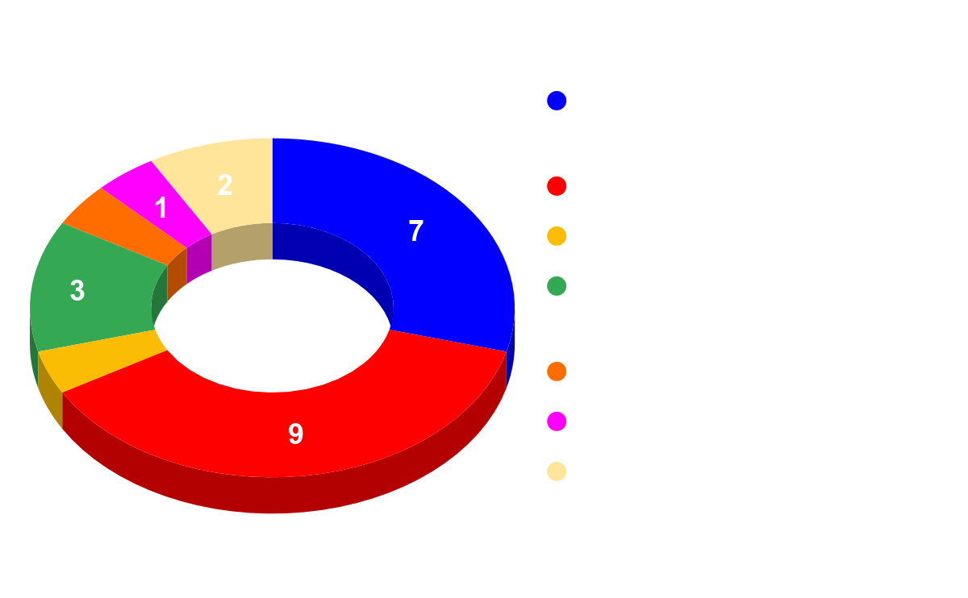
User Research

Slide 13
Notable Responses from Survey
What is the most frustrating step in searching and applying for job/internship/etc?
“I just hate having to put the same location when searching.” - Justin Z.
“I dislike seeing all the black text clumped together.” - Jordan Diaz
What new features would you like to see in Job Finding Apps?
“Add a better bottom bar. It is weird seeing the bottom section being empty in Indeed Job Search.” - Hudesh Dyal
What features do you like about the current job finding app you are using?
“I like the simple design of Indeed. I like how you can remove some options and save them.” - Md Faim Foysal

Slide 14
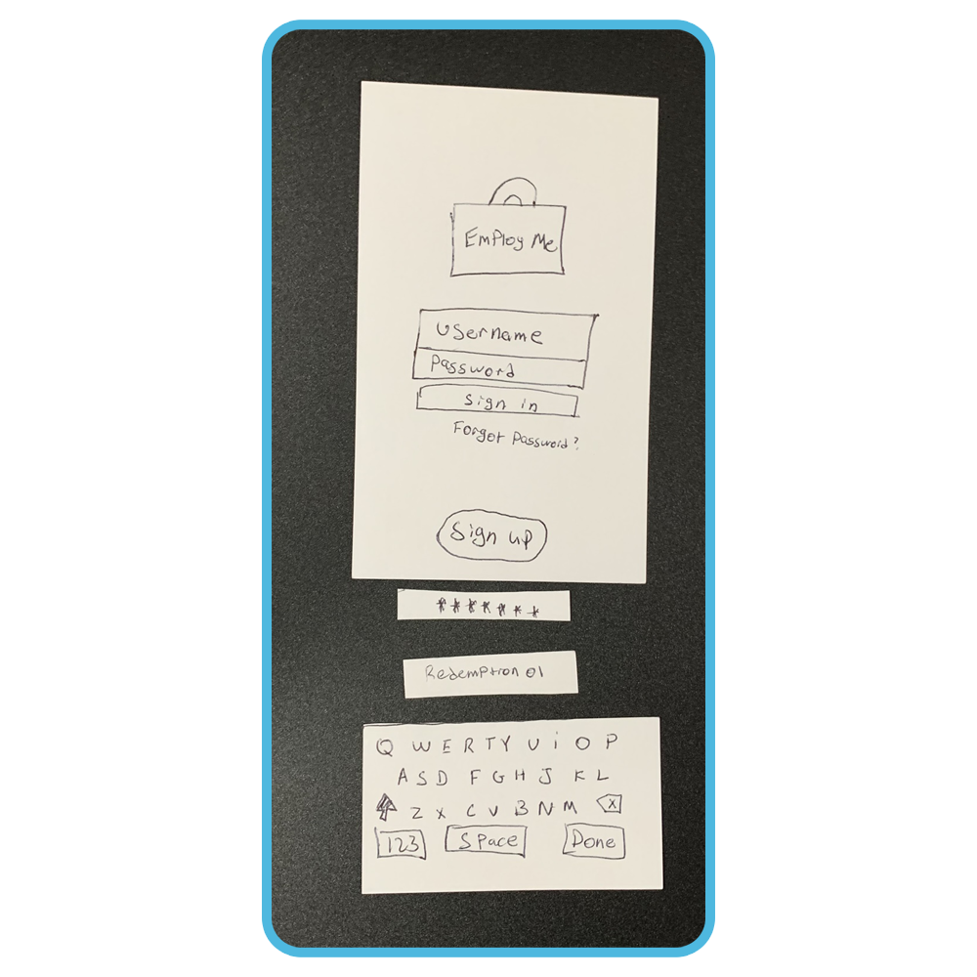
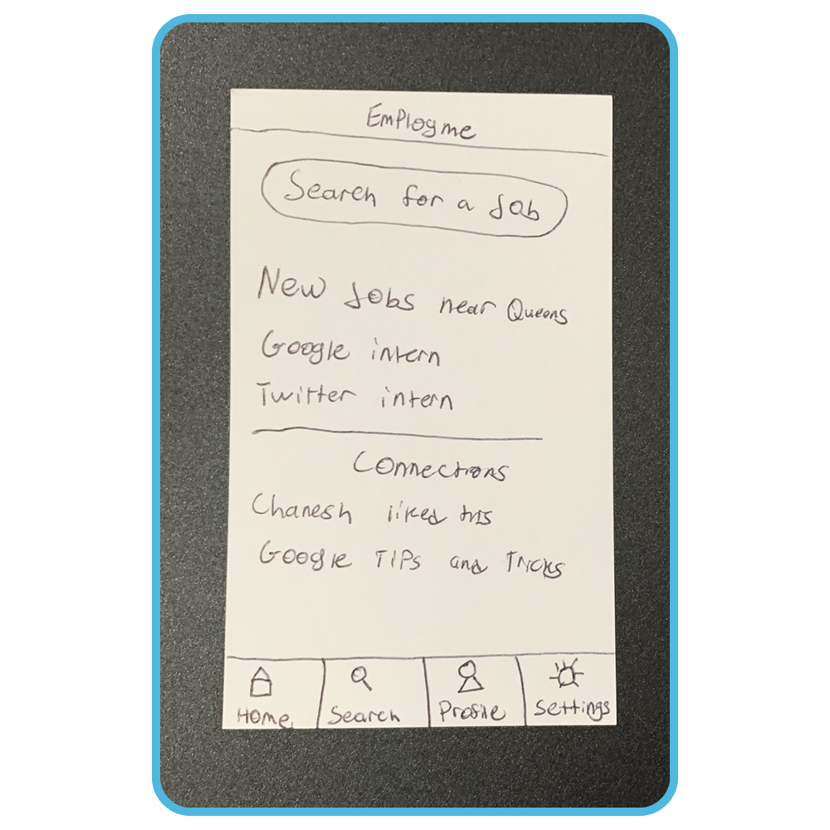
Paper Prototype

Slide 15
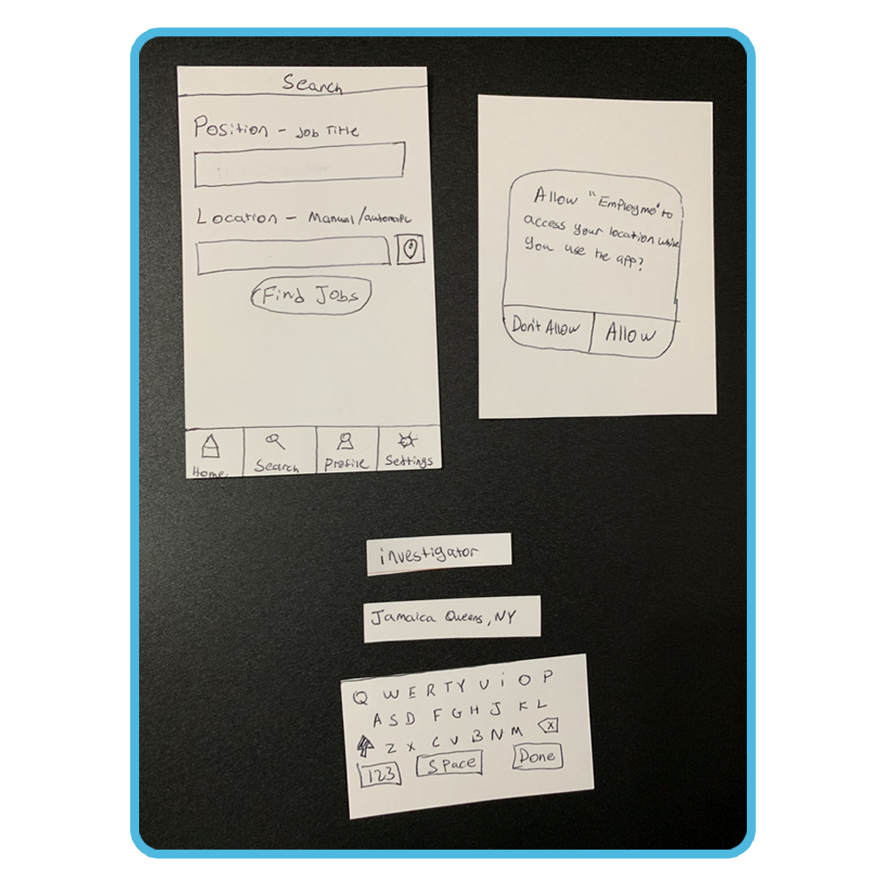
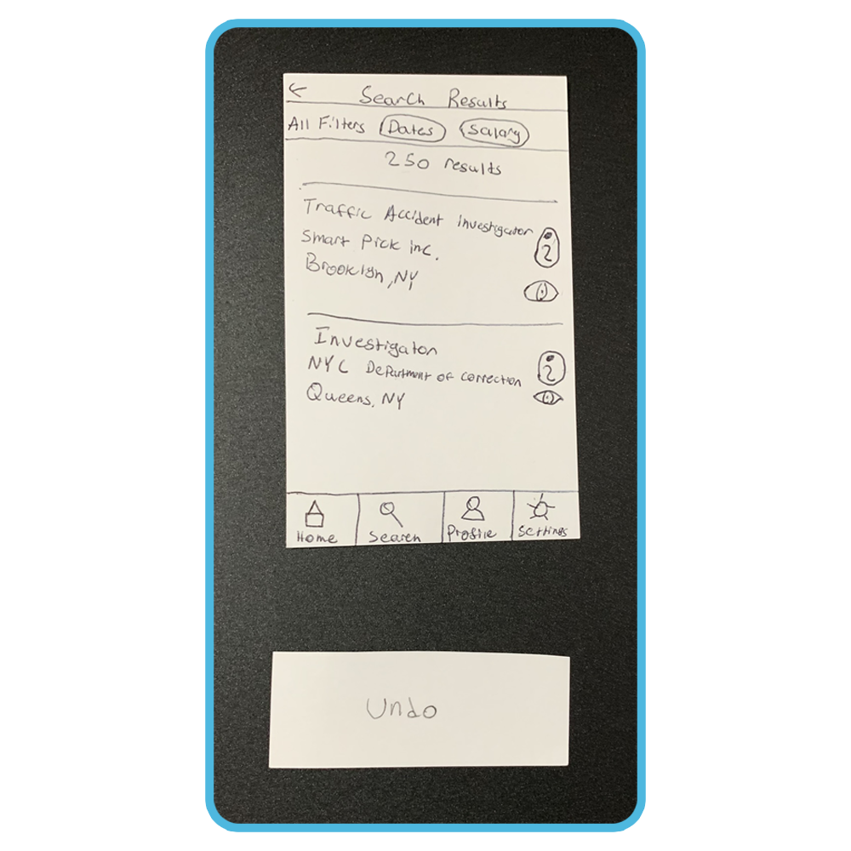
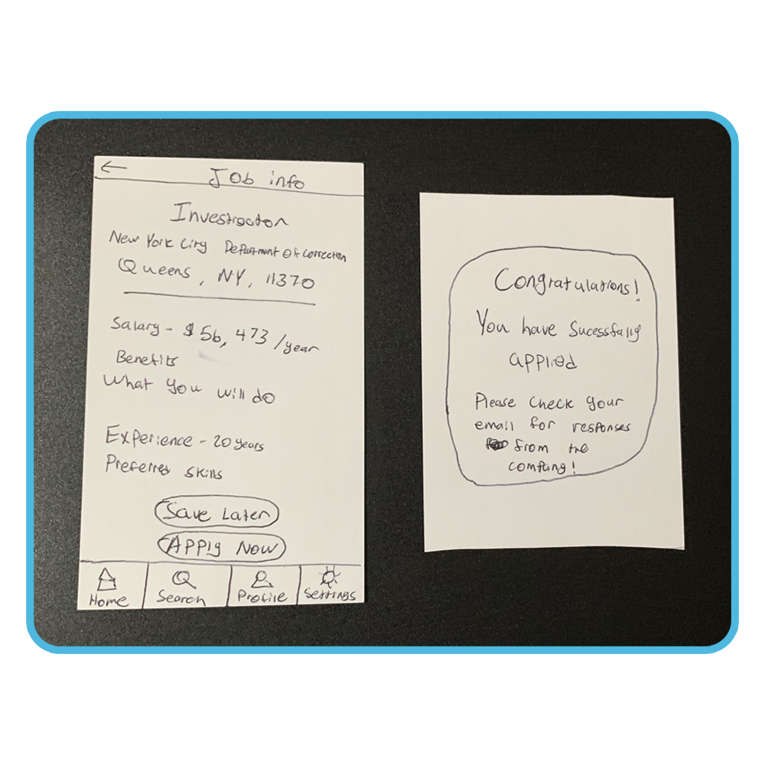
Paper Prototype
images

Slide 16
Notable Responses from Paper Prototype
“You should make the whole job result clickable. The small button is hard to notice. And you should remove the eye button. Those buttons are confusing.” - Chanesh M.
“I liked how you added the keyboard function into your paper prototype. It makes the experience feel more realistic. Overall, you should remove the eye icon and replace it with an ‘X’ button to remove an result.” - Qadeer Syed
“You should change the eye icon to an X icon. Overall I like the design so far. I am excited to see your final demo." - Marvin M.

Slide 17
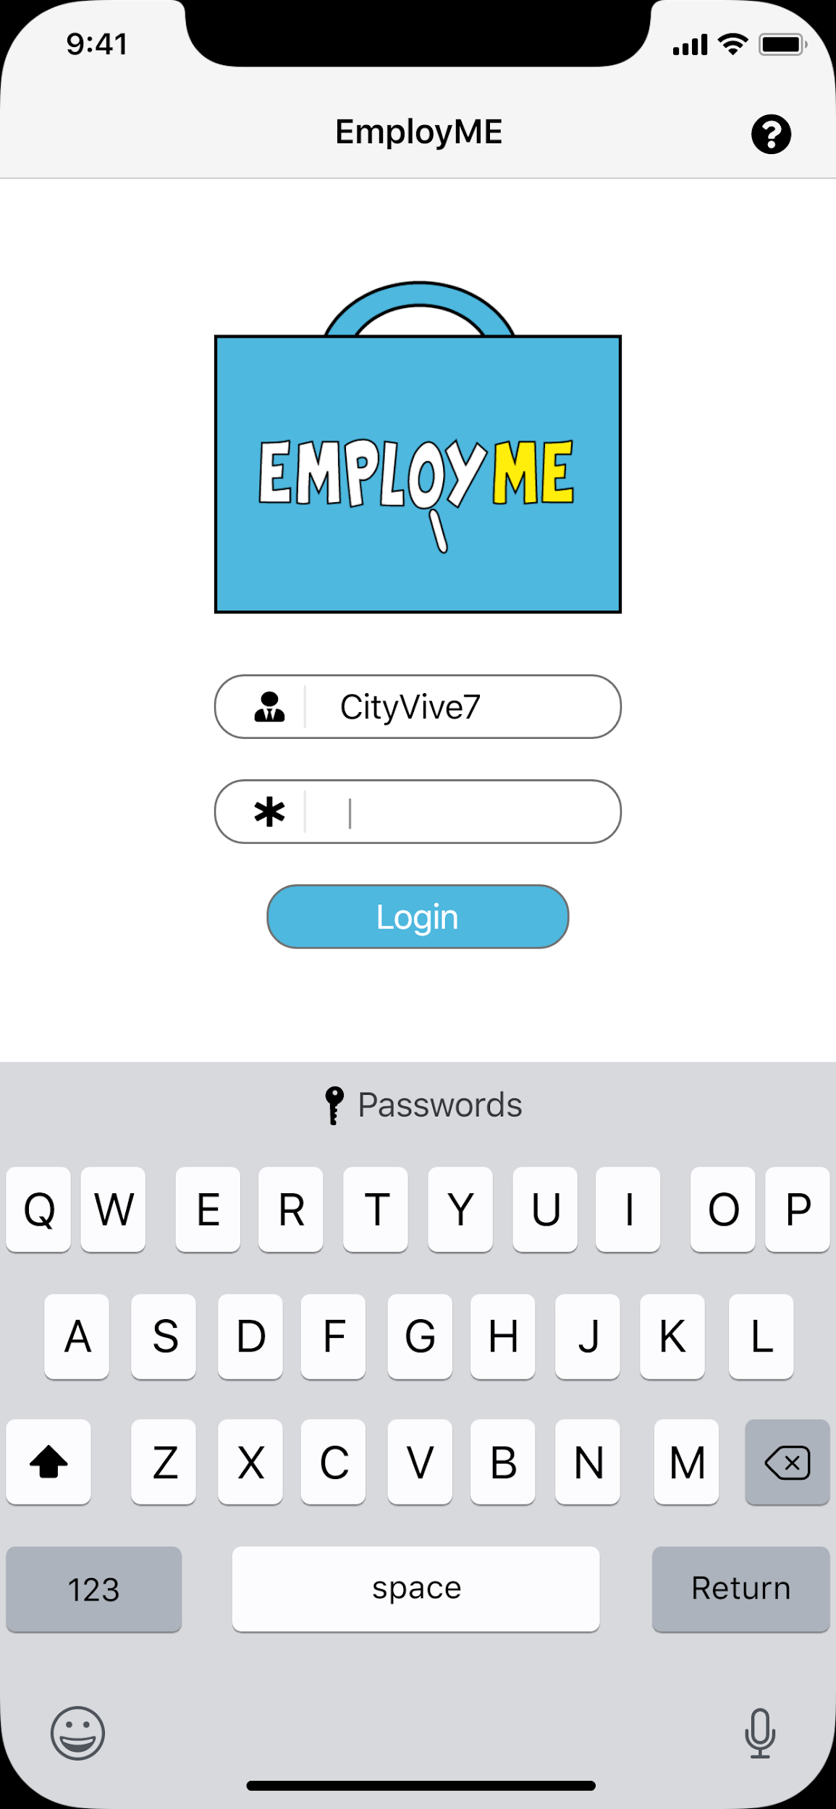
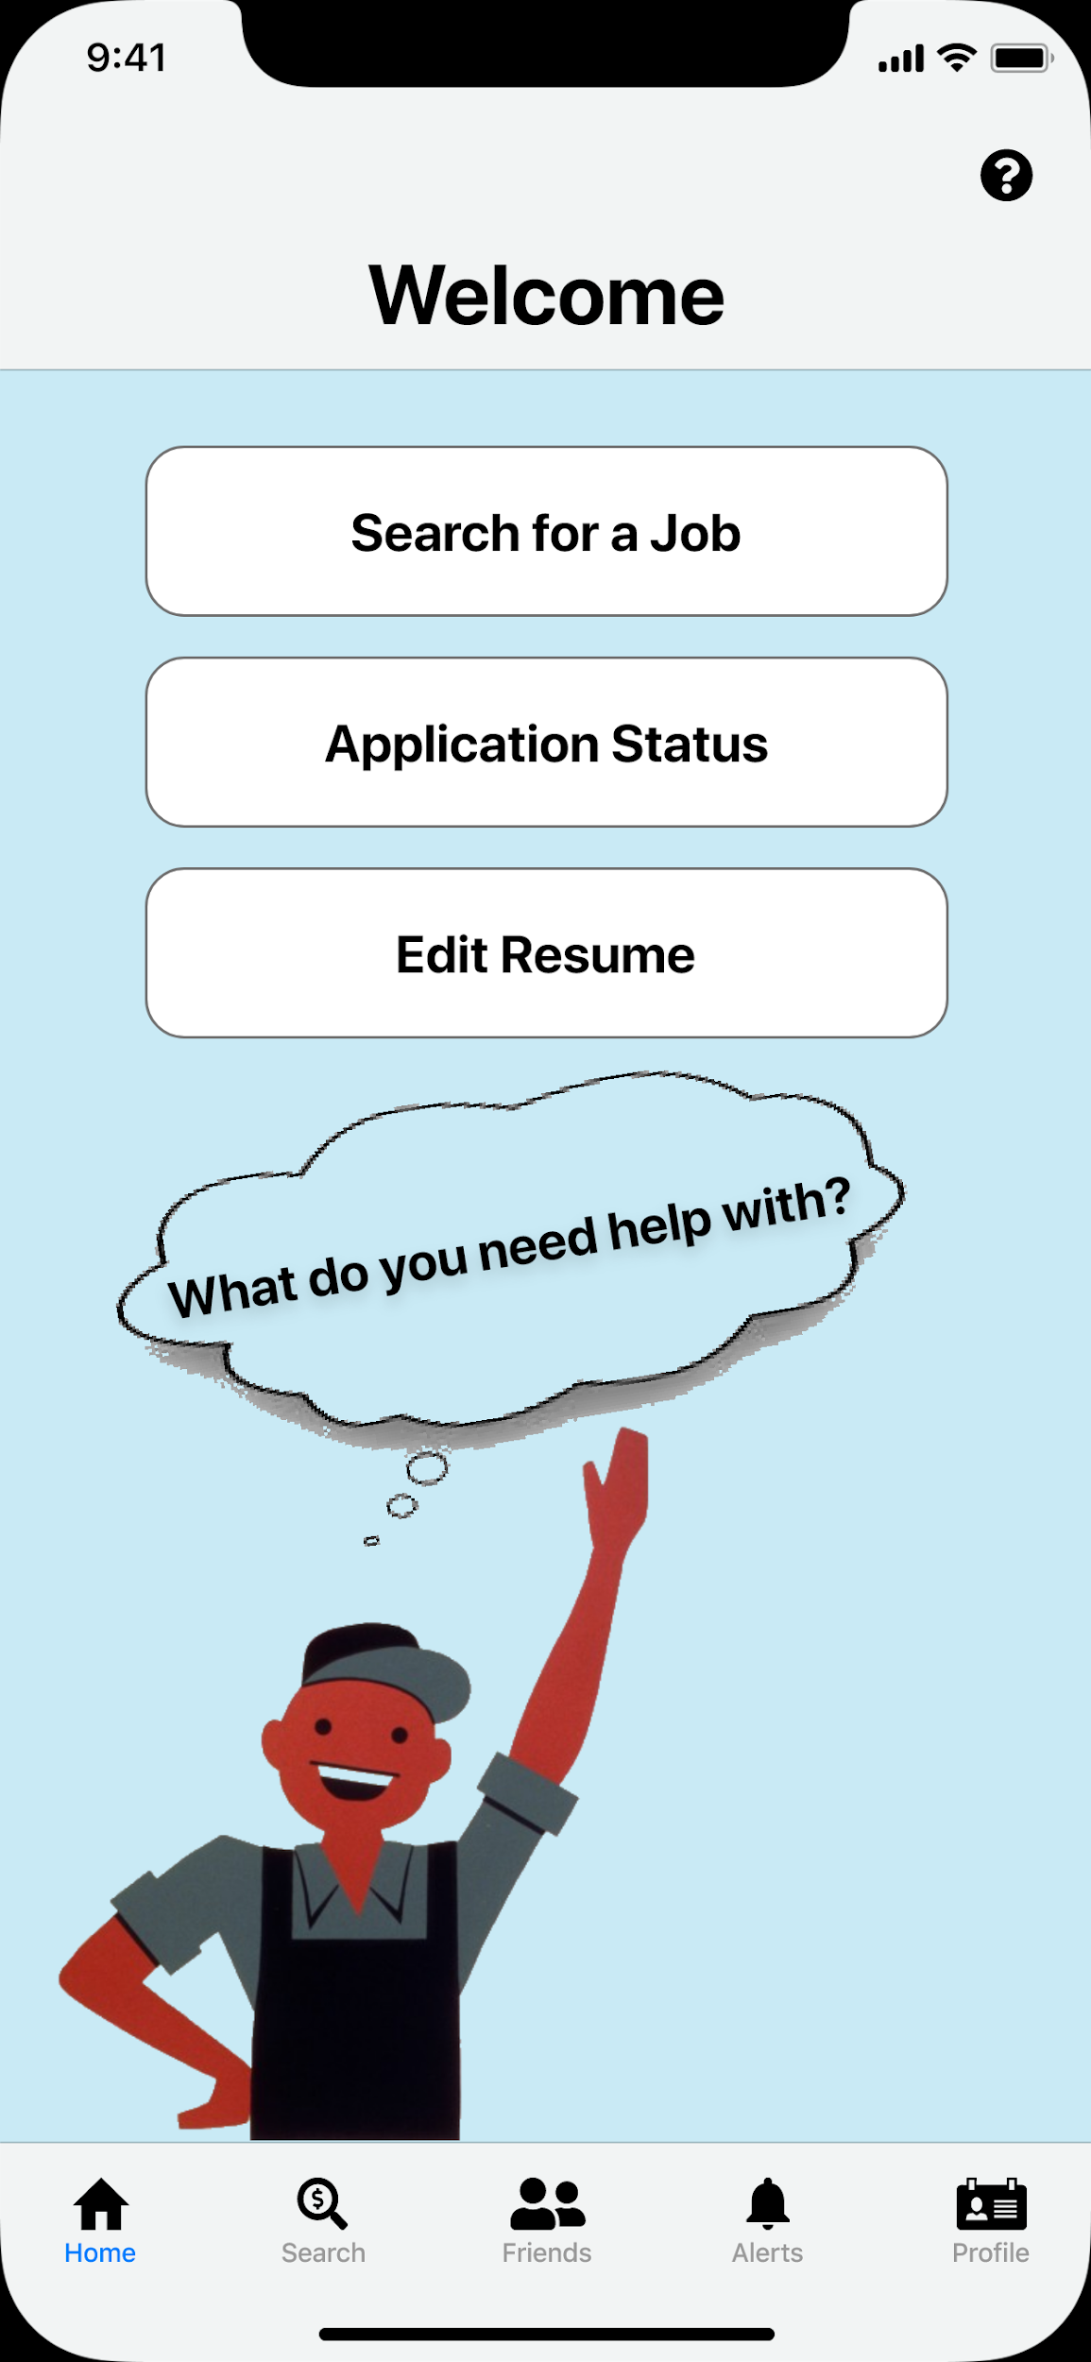
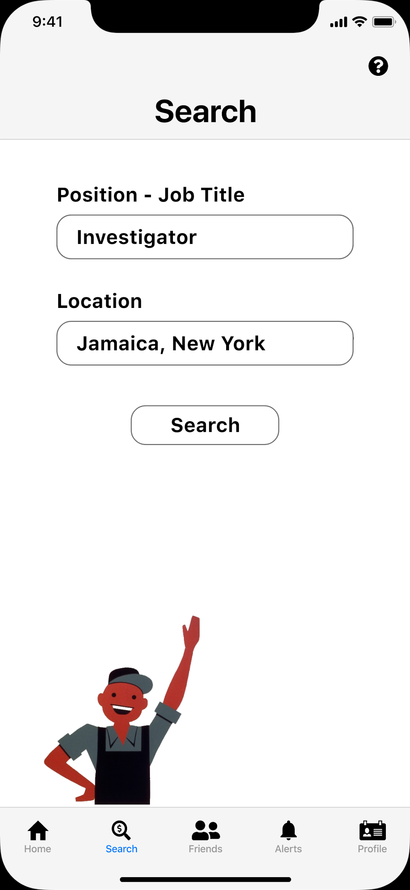
Wireframe Prototype

Slide 18
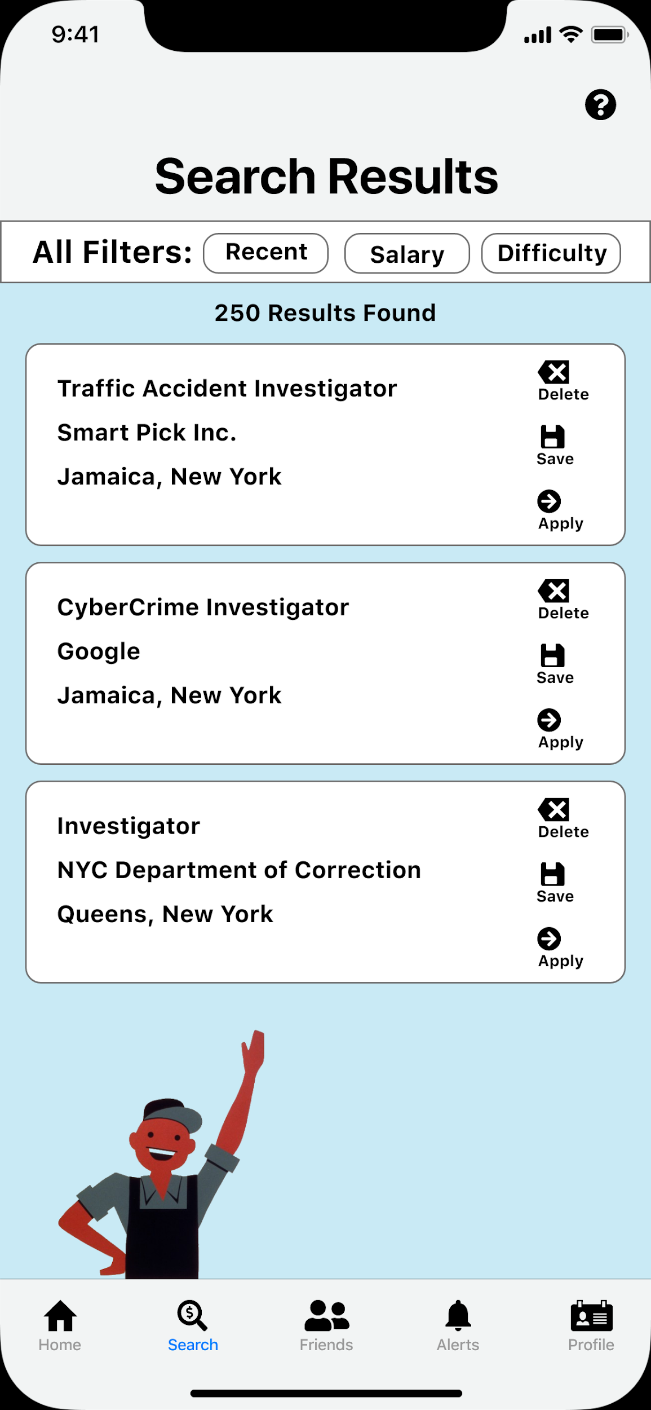
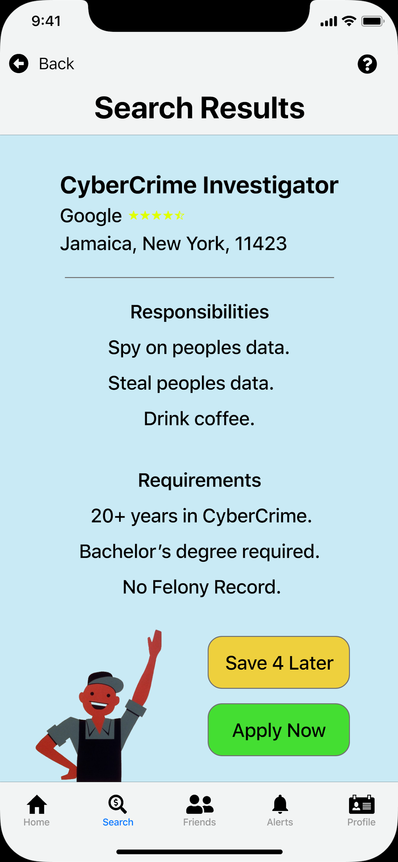
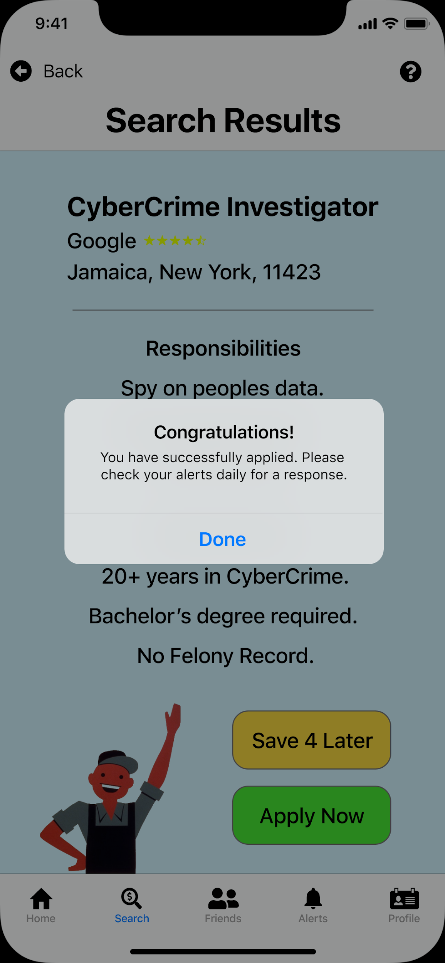
Wireframe Prototype

Slide 19
Notable Responses from Wireframe Prototype Testing
“I like how there is two paths to get to the search page. I also like the funny descriptions you added. You should make the mascot tell users tips and tricks.” - Qadeer Syed
“I like your overall demo but the prototype hotspots are very hard to click on the phone. You should also make the mascot tell users instructions on what to do.“ - Chanesh M.
“I like the global navigation bar that you added in the bottom. I also like how your demo looks like a real IOS app. You should mix up the mascots, so they aren’t the same on each page.” - Professor. Caroline Nelson

Slide 20
Final Design

Slide 21
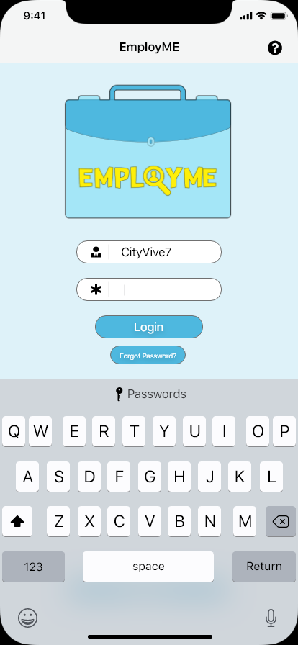
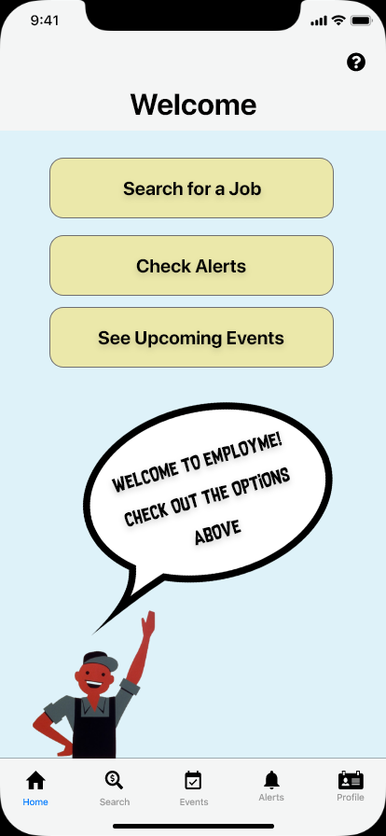
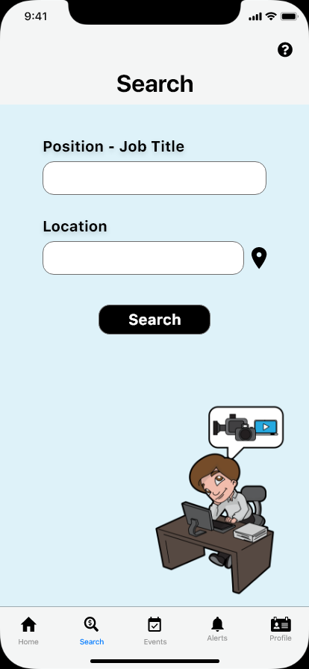
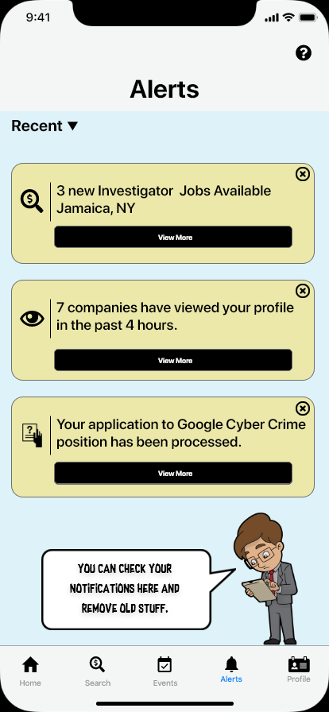
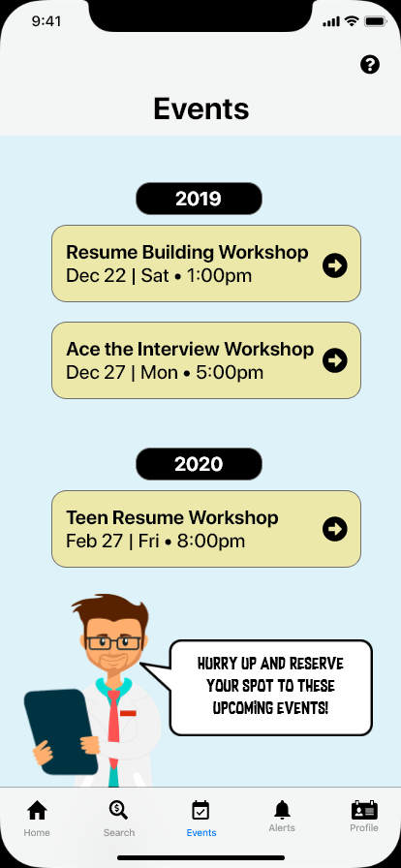
Images of 4 Main Pages in Final Design
PDF Attached with all Important Artboards

Slide 22
1st Red Routes
Jacob is a upcoming graduate at Queens College. He wants to check around his area for an investigator job at Google. He would find this in the EmployME app by…
Unlock iPhone, launch EmployME and Sign in.
Click on “Search for a Job” on home page.
Enter in position and location then press search.
Select specific job and apply.
Check alerts for an application response.

Slide 23
2nd Red Routes
William is a eager freshmen who has applied to a CyberCrime job. He wants to check the status of his application. He would find this in EmployME app by…
Unlock iPhone, launch EmployME and Sign in.
Click on “Check Alerts ” on home page.
Check if the application has been processed.
Click on view more and read application response.

Slide 24
3rd Red Routes
Dwayne is a lazy college student who has graduated but has no resume to apply for jobs. He needs assistance building a resume. He would get help in EmployME by….
Unlock iPhone, launch EmployME and Sign in.
Click on “See Upcoming Events” on home page.
Find an upcoming event that helps builds resumes.
Click on the event and press the reserve spot button.

Slide 25
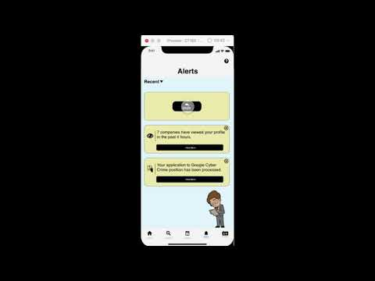
Movie

Slide 26
Conclusion
Overall, this project was quite fun to create. I felt that I have made a really solid design and presentation that could be used in selling an actual app. I mainly tried to make an app that felt realistic. I did so by using official IOS UI Kits. The only issues I had in this project would probably be the Sketch and Adobe XD compatibility. The surveys, paper prototypes, and user testings help make my app very detailed. Overall I am very satisfied with my designs.

Slide 27
The End
Thank you.

